Slide 1
BLOCK-CHAIN

Slide 2
Introduction :
A blockchain is a decentralized, distributed ledger that is used to record transactions across a network of computers. It allows participants to record, verify, and transfer data in a secure, tamper-evident way without the need for a central authority.
The technology was first used as the underlying infrastructure for the digital currency, Bitcoin, but has since been applied to a wide range of other fields, including supply chain management, voting systems, and intellectual property rights.

Slide 3
What makes it secure?
Blockchains are composed of blocks of data that are linked together in a chronological chain. Each block contains a timestamp and a link to the previous block, ensuring that the data cannot be modified once it has been recorded.
This makes blockchains highly secure and resistant to tampering. Additionally, because they are decentralized and distributed, they are also resistant to downtime or censorship.

Slide 4
Advantages
One of the key advantages of blockchain technology is its ability to facilitate trust between parties who may not know each other or may not trust each other. Because of the decentralized nature of the technology, no single party has control over the data, making it difficult for any one party to manipulate the data for their own gain.
Decentralization: Blockchain technology is decentralized, meaning that it is not controlled by any single entity or authority. This makes it resistant to tampering, downtime, and censorship.
Security: Because of the way that it is designed, blockchain technology is highly secure and resistant to hacking and other forms of cyberattack. This makes it an attractive option for storing and transmitting sensitive data.

Slide 5
Immutability: Once data has been recorded on a blockchain, it cannot be modified or deleted. This ensures the integrity of the data and makes it easy to verify its authenticity.
Transparency: All transactions on a blockchain are recorded and visible to anyone with access to the network, making it a transparent and accountable technology.
Efficiency: Blockchain technology has the potential to streamline many processes and make them more efficient by reducing the need for intermediaries and other third parties.
Accessibility: Because it is decentralized, blockchain technology can be accessed by anyone with an internet connection, making it a potentially inclusive technology.

Slide 6
Some of the uses of blockchain
Digital currencies: Blockchain technology was originally developed as the underlying infrastructure for the digital currency, Bitcoin. It allows for the creation and transfer of digital assets without the need for a central authority ex: bitcoin, etherium etc...
Supply chain management: Blockchain technology can be used to create more efficient and transparent supply chain systems. It can help to track the movement of goods and materials from production to consumption, ensuring that they are handled and transported in an accountable and transparent way.
Voting systems: Blockchain technology has the potential to revolutionize the way that elections are conducted. It could be used to create secure and transparent voting systems that are resistant to tampering and fraud.

Slide 7
Identity management: Blockchain technology could be used to create secure and verifiable systems for managing digital identities. This could help to reduce fraud and ensure that individuals have control over their own personal information.
Smart contracts: Blockchain technology can be used to create self-executing contracts that are automatically enforced once certain conditions are met. This could be used to automate complex business processes and reduce the need for intermediaries.
Digital rights management: Blockchain technology could be used to create systems for managing and protecting intellectual property rights. It could help to ensure that creators are fairly compensated for their work and that their rights are properly enforced.

Slide 8
Disadvantages
Scalability: Blockchains, especially public ones, can experience issues with scalability due to the large amount of data that needs to be stored and maintained.
Cost: Maintaining a blockchain network can be quite costly, and depending on the network, transaction fees can add up quickly.
Security Risks: Blockchains are generally secure, but due to their distributed nature, there is a risk of fraud and malicious attacks that can compromise the network.

Slide 9
Privacy Concerns: Blockchains are public and transparent, which means that all transactions on the network are visible to everyone. This can be a problem if you need to maintain privacy.
Lack of Regulations: The cryptocurrency world is largely unregulated, which can make it difficult to find reliable and trustworthy blockchain networks.

Slide 10
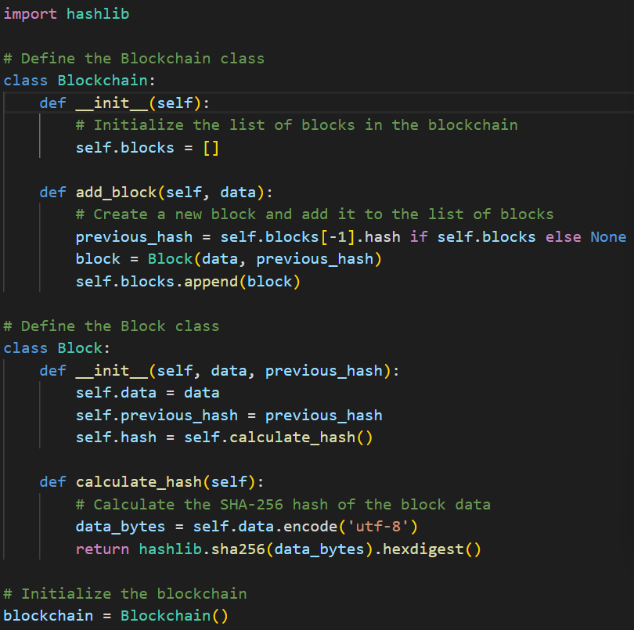
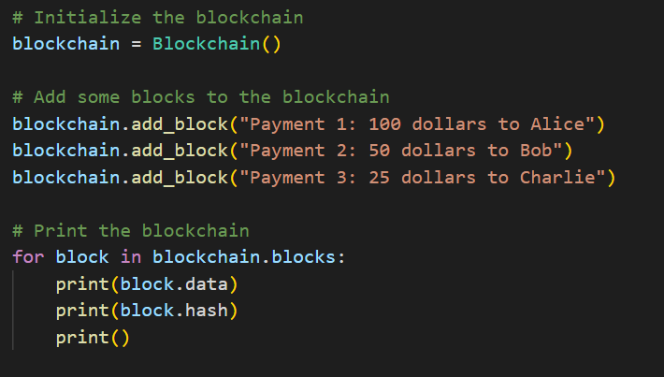
Python code implementing blockchain

Slide 11
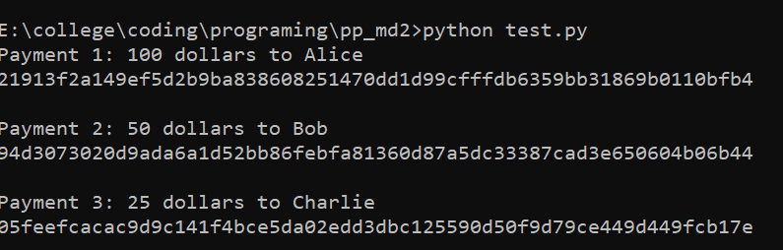
Output:

